Slide 1
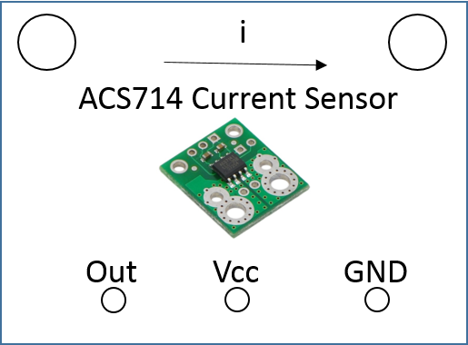
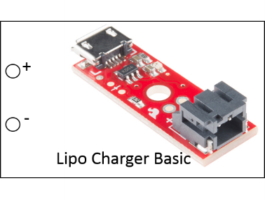
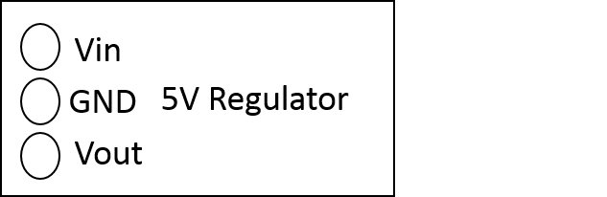
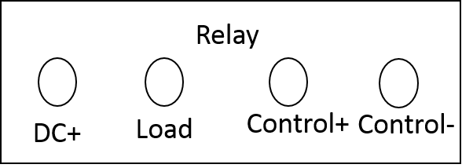
Bat 3.7-4.2V
Due Vin
Due I/O Pin
Due 5V
Due Control Pin
5V High current line
Batt GND
Due GND

Slide 2
QuadBot Board
Bat 3.7-4.2V
Due Vin
Due I/O Pin
Due 5V
Due Control Pin
5V High current line
Batt GND
Due GND

Slide 3
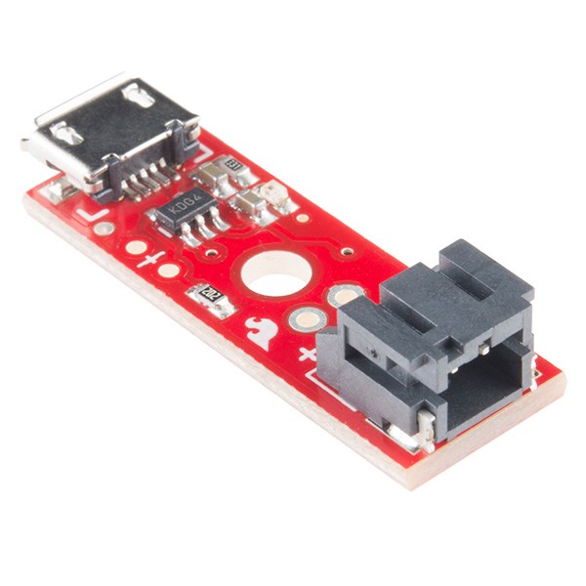
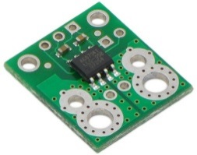
Vin
WW
GND
Vout
+
-
Lipo Charger Basic
i
Relay
ACS714 Current Sensor
DC+
Load
Control+
Control-
Out
Vcc
GND

Slide 4
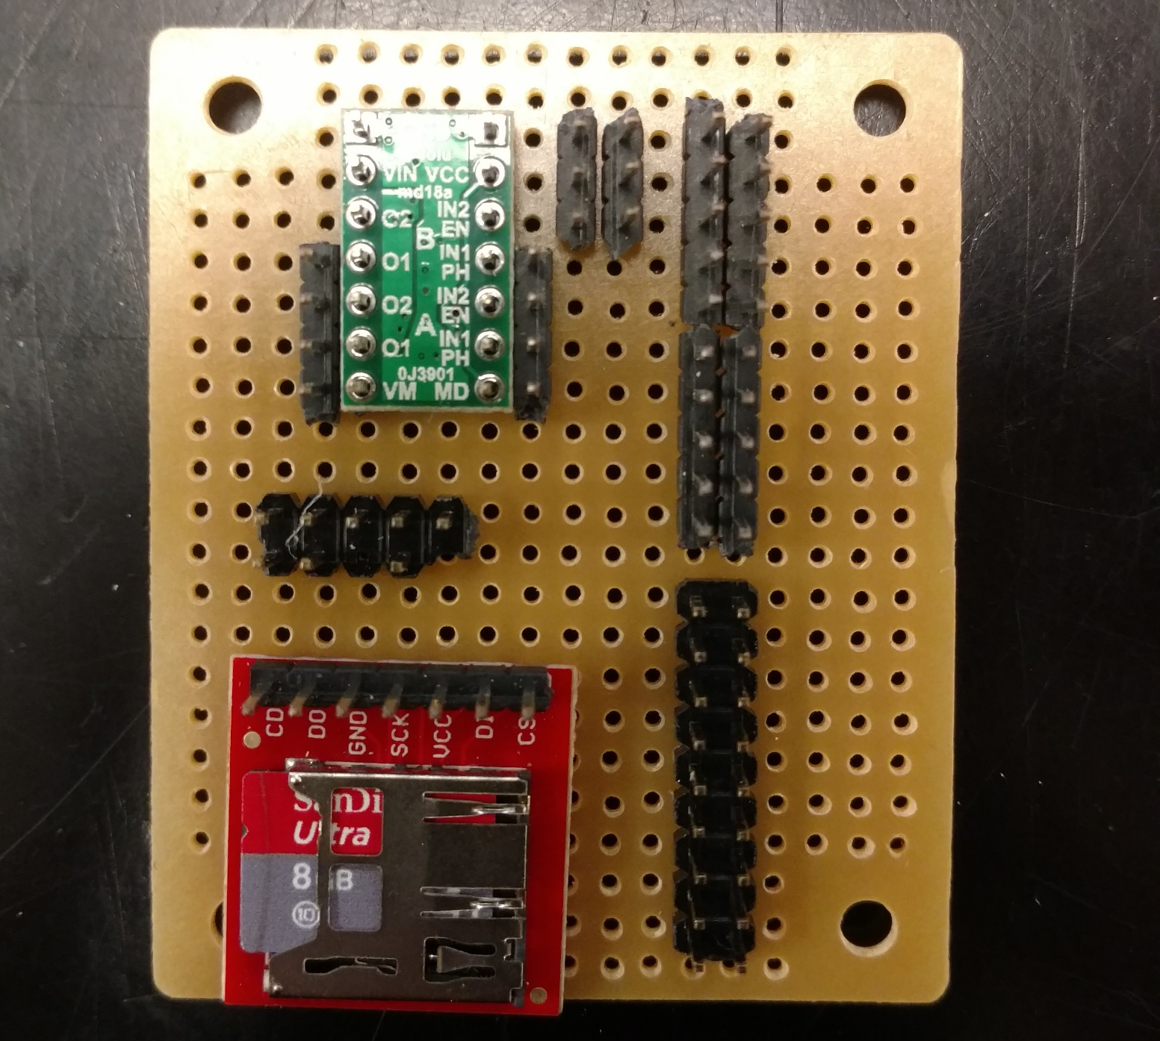
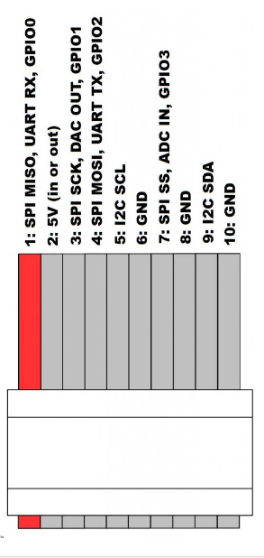
5V High Current
GND Due
GND
5V Due
3.3V Due
Due Pin 4

Slide 5
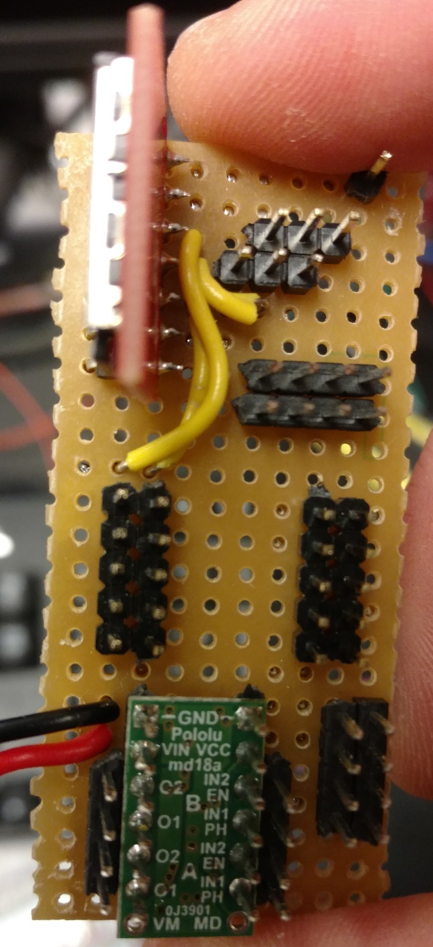
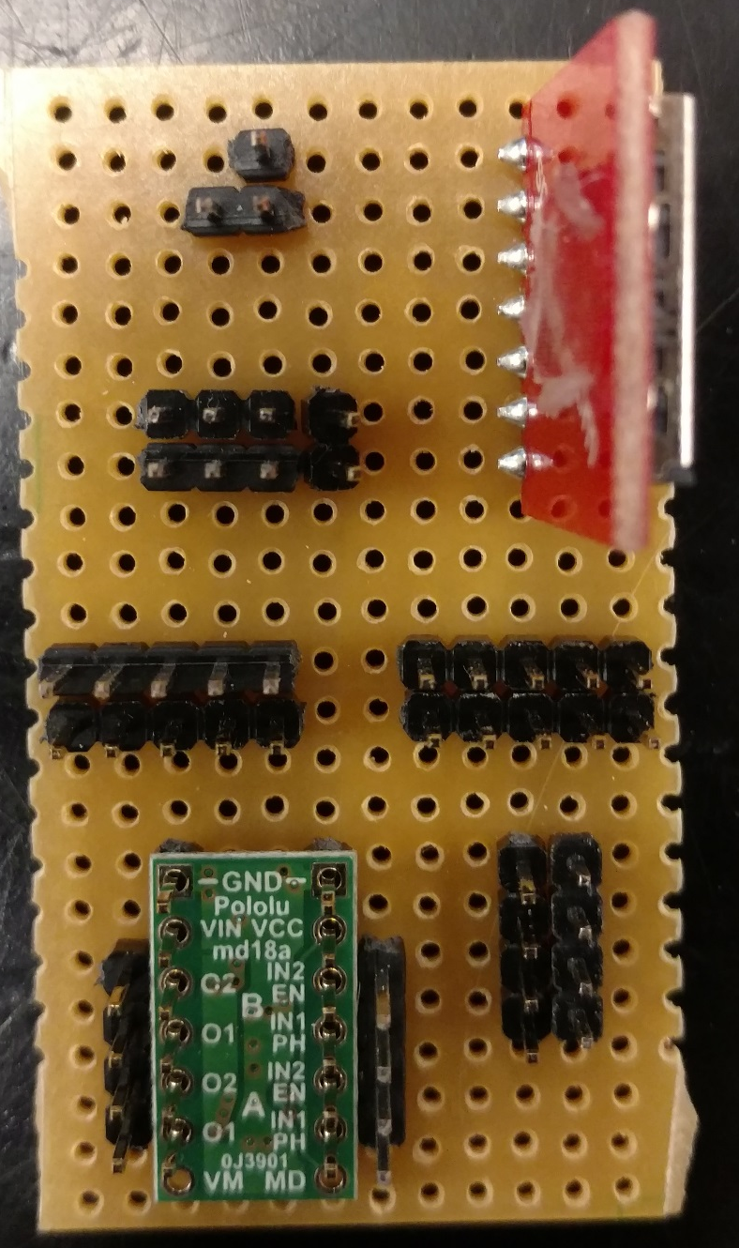
1 2
3 4
5 6
7 8
9 10
SPI Ribbon - Chip Reader:
1 – D0
3 – SCK
4 – D1

Slide 6
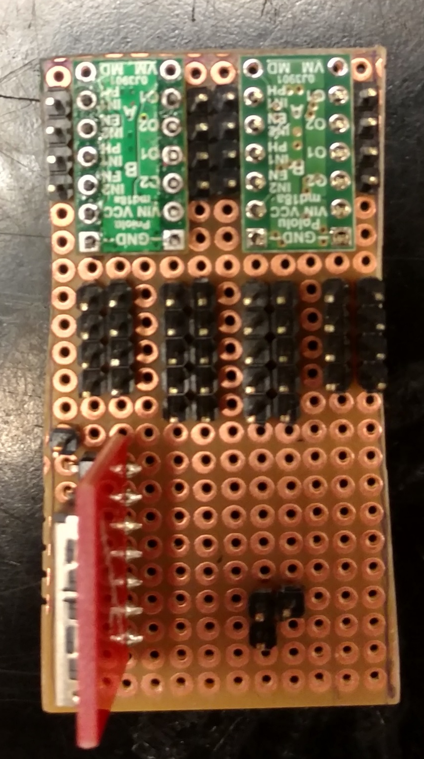
MB2
MB1
BATT+
BATT GND
SCL/SDA Lines
5V Reg +
5V Reg GND
Due 5V+
Due GND
Due GND
Due 3V+

Slide 7
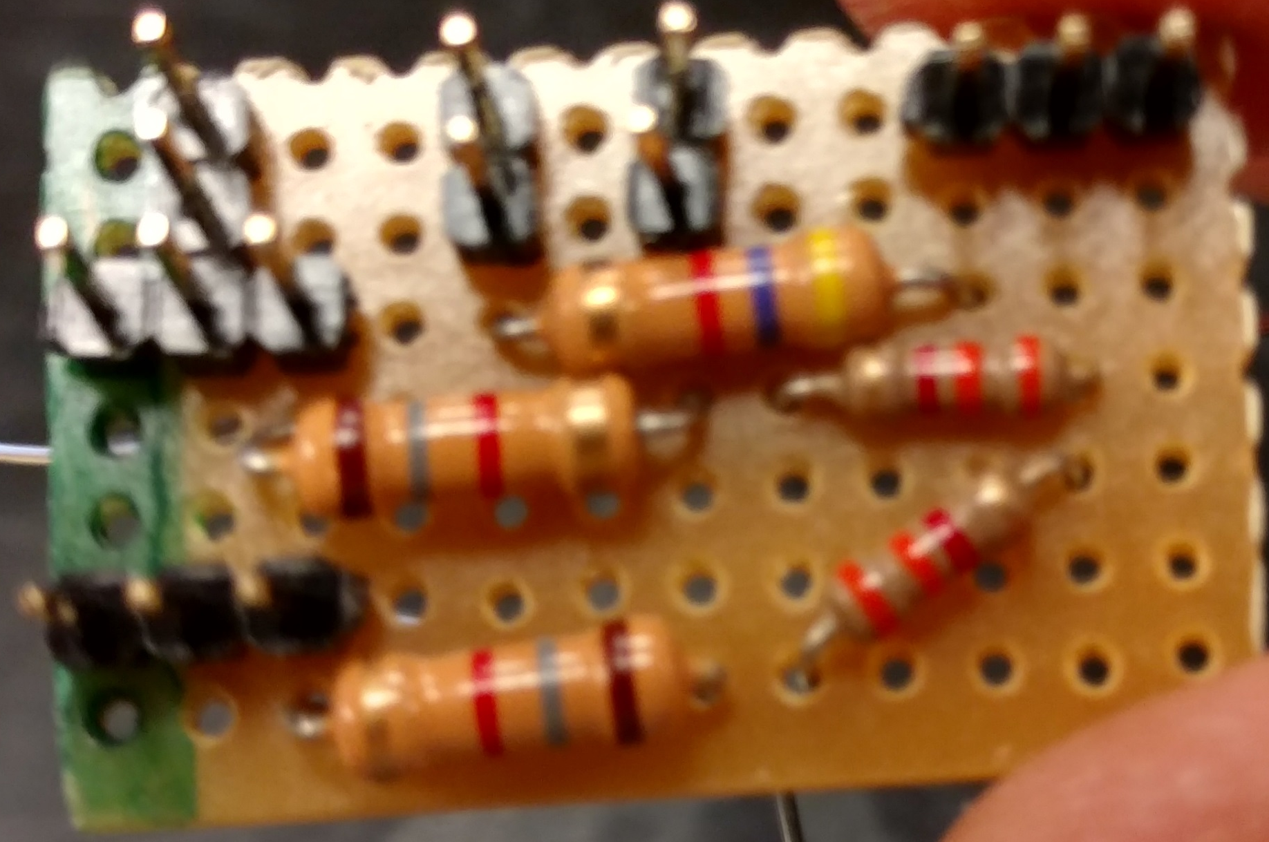
FSR, Hall Effect Sensors, and Charging Rod Detector Circuit
Due 5V+
Due GND

Slide 8
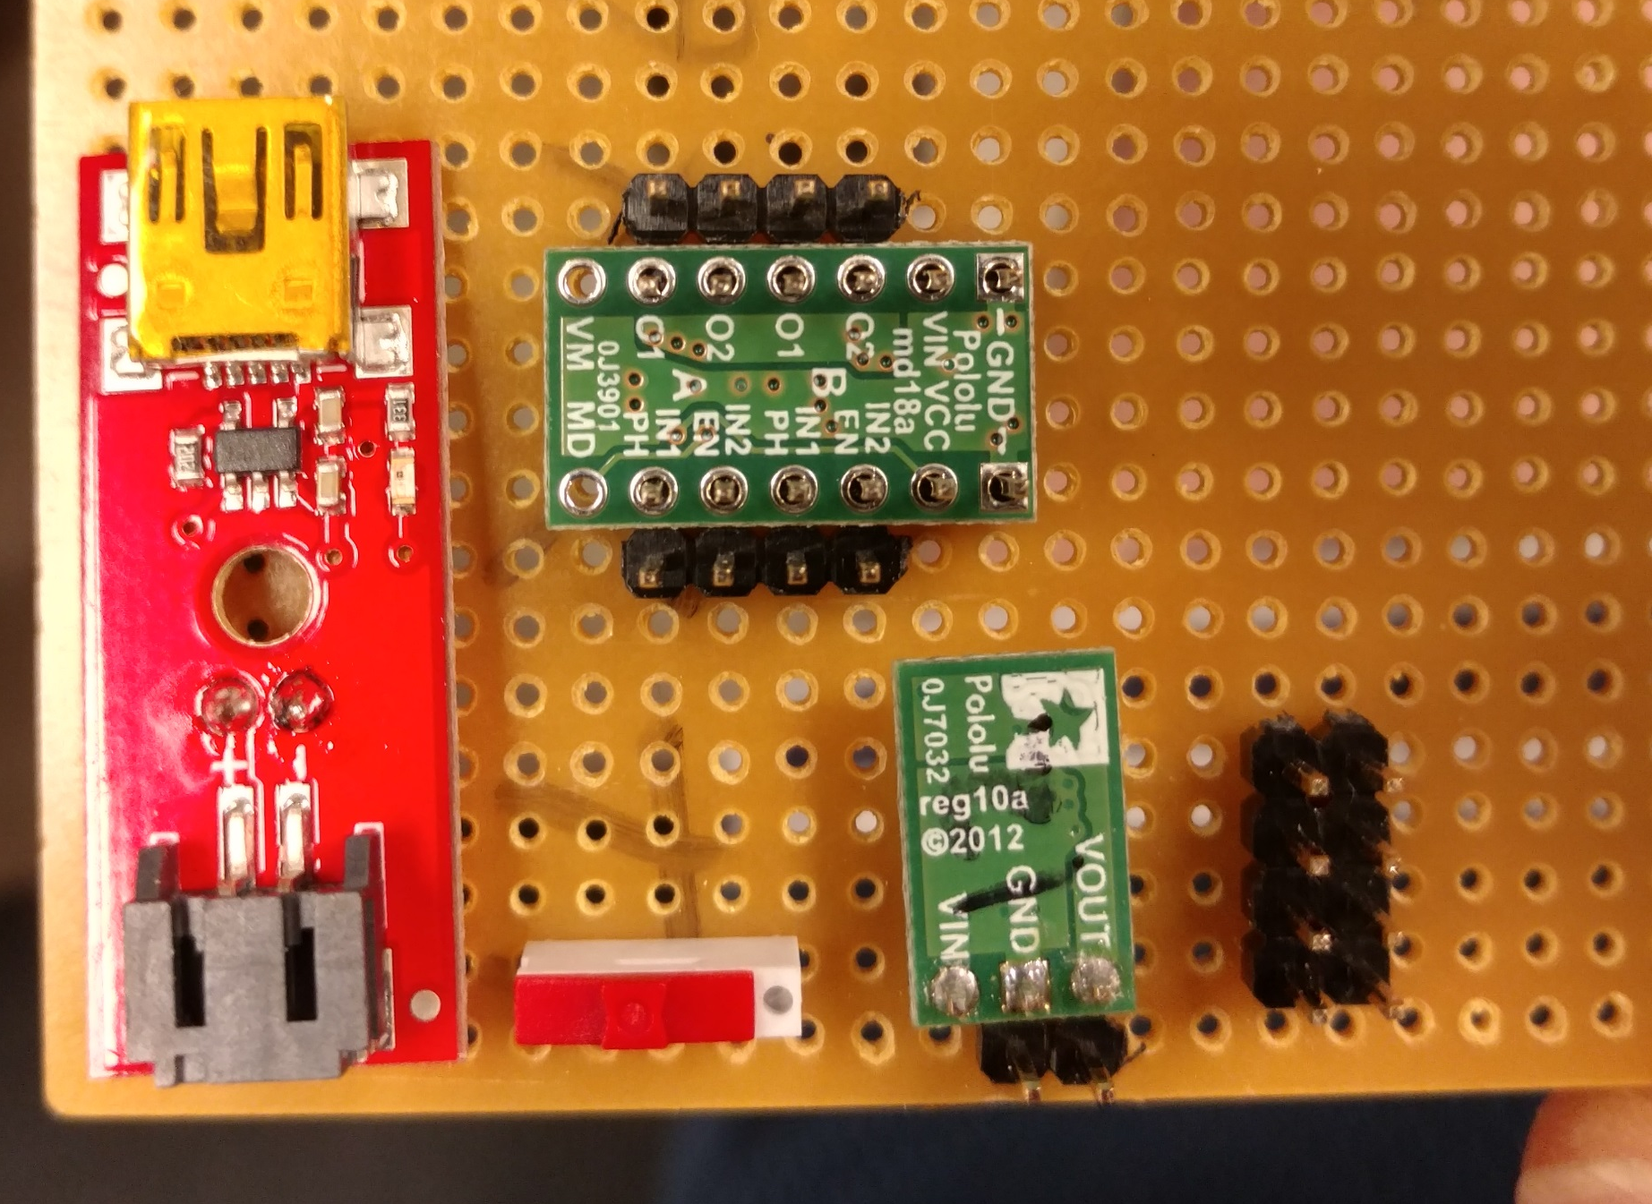
IR Sensor Hookup
Due GND
Due 5V+
Due Vin

Slide 9
Front of Robot
0
1
2
3
4
5
6
7
Back of Robot

Slide 10
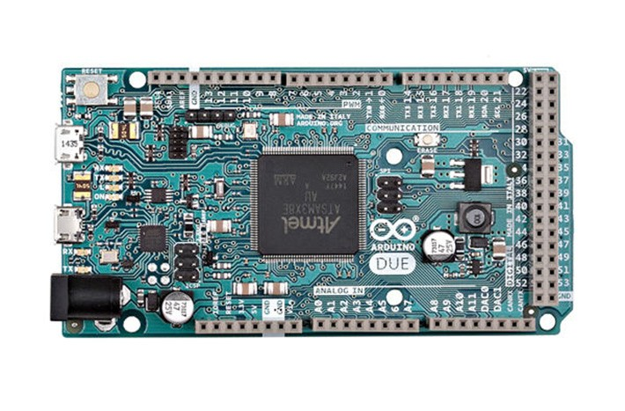
All connected pins are separated by 100 mil
160 mil
200 mil
300 mil
800 mil
200 mil
200 mil
200 mil
100 mil
1096 mil

